Slide 1
Fundamentals of Computer Science COMPUTATIONAL THINKING Achieving Focus

Slide 2
ANNOUNCEMENT – CS STUDENTS ONLY
Combined Academic Librarian session for Wednesday CS students only
JG226 – Library Lab on Wednesday 27th November from 12:00 until 13:00, then continue with the rest of the tutorial

Slide 3
Link between human and computer
Understanding how we turn the written word into understanding is a real challenge for computer scientists.
Get it right and you can build computers that understand the written word, a really useful thing to do.
A written sentence has two parts -
the syntax
the semantics

Slide 4
Syntax
Syntax relates to the structure of language.
Looks at rules - what is allowed to follow what.
Ignores meaning.
As a child, we learn to pay attention to grammatical structure AND lexical (meaningful) words.
As adults we learn to take shortcuts, making reading more fluid.

Slide 5
Figuring out Messy Data
'Aoccdrnig to rscheearch, it deosn't mttaer in waht oredr the ltteers in a wrod are, the olny iprmoetnt tihng is taht the frist and lsat ltteer be at the rghit pclae. The rset can be a toatl mses and you can sitll raed it wouthit porbelm. Tihs is bcuseae the huamn mnid deos not raed ervey lteter by istlef, but the wrod as a wlohe’
What is the logic behind figuring out the messy sentence above?
In other words - how could we programme a computer to understand messy data?

Slide 6
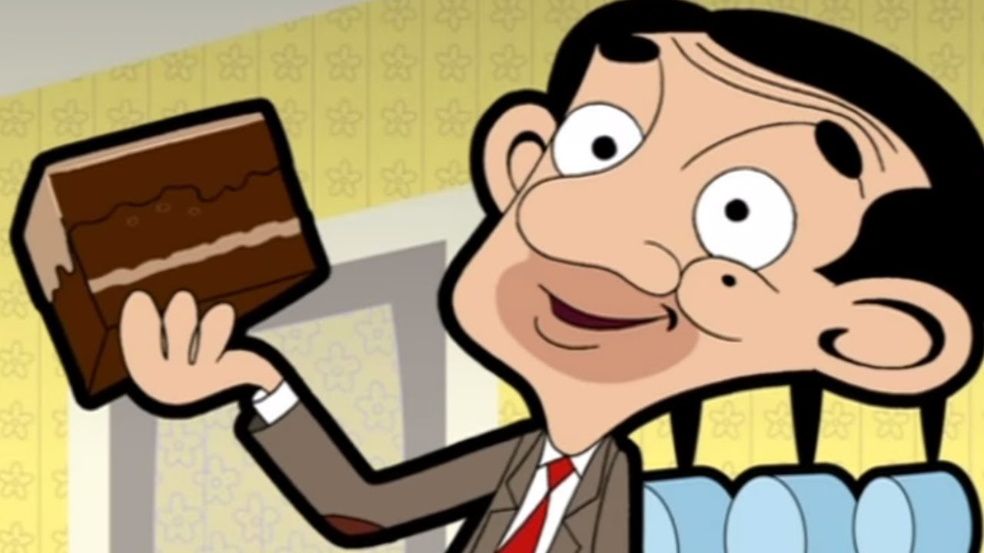
Semantics
It is about the meaning of words.
It is not what you say, it’s the way you say it.
Consider these 6 examples:
'I didn't steal granny's chocolate cake '- Wasn't me, was someone else!
'I didn't steal granny's chocolate cake '- It really wasn't me!
'I didn't steal granny's chocolate cake '- I planned to give it back, honest!
'I didn't steal granny's chocolate cake '- It was actually Uncle Johns’ I stole!
'I didn't steal granny's chocolate cake '- It was her vanilla sponge cake I nicked!
'I didn't steal granny's chocolate cake '- It was her bar of chocolate!

Slide 7
The Computer is better than you
Well, sometimes! Consider this example:
FINISHED FILES ARE THE RESULT OF YEARS OF SCIENTIFIC STUDY COMBINED WITH THE EXPERIENCE OF YEARS
Our vision and cognition are fixated on lexical words, ignoring the grammatical syntactic words.
Fast and fluid (usually) gets you there.

Slide 8
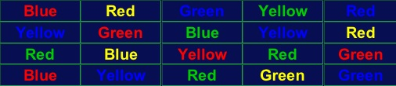
Colouring your Perception
Say the colour of the following words out loud quickly
The Stroop Effect
A popular neuropsychological test to detect interference effect
Are you capable of filtering out interference?
Can you trust your brain?

Slide 9
Generalisation
A way of quickly solving new problems based on previous problems we have solved.
We can take an algorithm that solves some specific problem and adapt it so that it solves a whole class of similar problems.
Then whenever we have to solve a new problem of that kind we just apply this general solution.

Slide 10

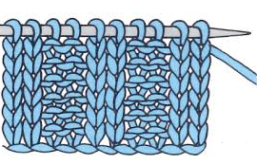

Generalisation
How your jumper is like coding
Knit (k)
Knit (k)
Purl (p)
What do you see here?
Purl (p)

Slide 11
Generalisation
A series of waves and Vs forming patterns
Knitting a simple square:
‘30k (30 knit stitches), finish the line, then repeat this 20 times’
Coders do the same when writing computer programs.

Slide 12
Regular Expressions
Programmers use regular expressions.
A aspect of theoretical computer science and formal language theory.
A sequence of characters that define a search pattern, used by a string searching algorithm:
For ‘find’ or ‘find and replace’ operations on string
For input validation

Slide 13
Regular Expressions
If we ‘knitted’ a regular expression:
Row 1: *k1, p1; rep from * Row 2: *p1, k1; rep from *
or
Row 1: (K1, P1) rep to end Row 2: (P1, K1) rep to end Repeat these 2 rows for length desired.
Knitting patterns are meant to be read by a human.
How do we experiment in writing knitting software?
We have to use a notation a computer can easily follow:
Regular expressions fit the bill!

Slide 14
Regular Expressions
Let’s begin by naming the expression
Let’s represent a knit stitch that’s immediately followed by a purl stitch kp
Repeated actions can be placed in curved brackets (kp)
The number of times an action is repeated can be represented in curly brackets {10}
kp repeated 10 times looks like this: (kp){10}.

Slide 15
Regular Expressions
We represent row as \n, to indicate that a new line (=row) has to start.
The full regular expression for the row is then (kp){10}}\n. Since the first line was made of repetitions of kp the following line must be made of repetitions of pk, or (pk){10}\n
These two lines have to be repeated a certain number of times themselves, say 20, so they are in turn wrapped up in yet more brackets, producing: ((kp){10}\n(pk){10}\n){20}.

Slide 16
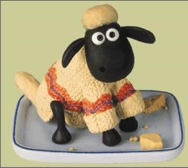
Regular Expressions
If we want to provide a more general pattern, not fixing the number of kp in a row or the number of rows, the 10 and 20 can be replaced with what are called variables - x and y.
They can each stand for any number, so the final regular expression is:
((kp){x}\n(pk){x}\n){y}
Preciseness is key
You’ll never look at a woolly jumper the same way again!

Slide 17
More Algorithms
Locked-in Syndrome
A person with locked-in syndrome is totally paralyzed except perhaps being able to move an eyelid.
They can see, hear and think but they cannot communicate back.
Their intelligent mind is trapped inside a useless body.

Slide 18
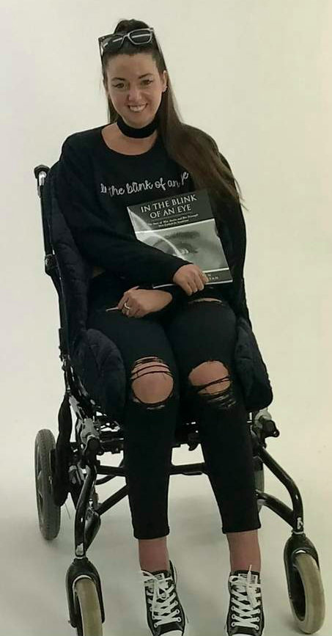
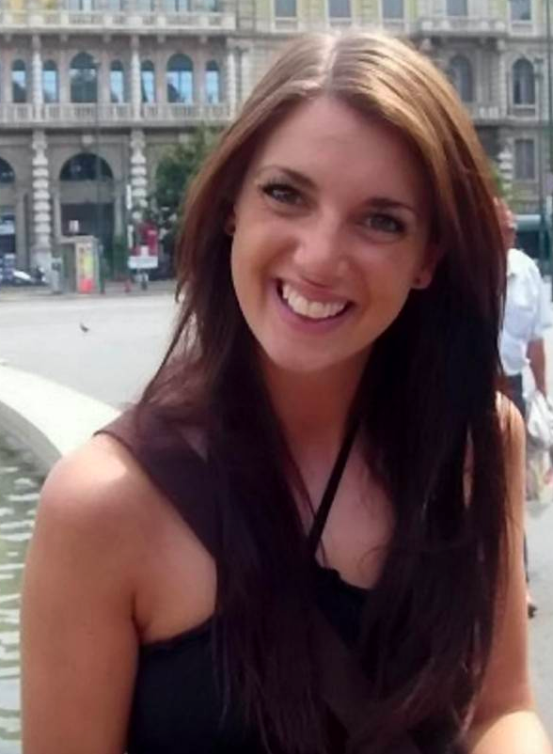
More Algorithms
Mia Austin’s experience of Locked-in syndrome
She can’t speak so she has a computer which recognises her eye gaze and will spell things out which keeps her updated.

Slide 19
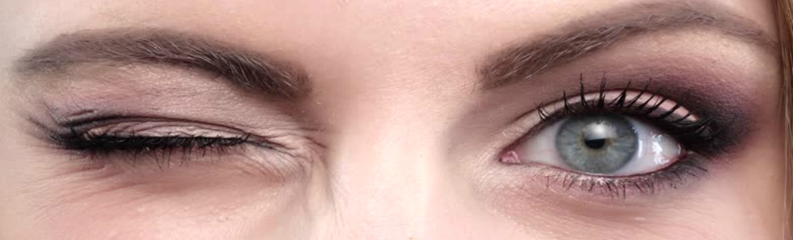
More Algorithms
Communicating with Locked-in Syndrome
The helper reads the alphabet a letter at a time
Is it A?
Is it B?
Is it C? And so on
Blinking means yes, not blinking means no
The helper writes the letter down.
Then starts again with the next letter

Slide 20

How well would that work?
Let’s try it!
What problems need to be solved?
to make it really work
Can it be improved?
How fast is it?
How long would it take to write a book?

Slide 21
How fast would it work?
How fast is it?
It is very slow
It takes on average 13 questions for every letter
At worst it takes 26 questions
In identifying problems, coming up with solutions and faster ways, you are doing computational thinking!

Slide 22

Applying Computational Thinking
20 questions game
I think of a famous person.
You have to guess who I am thinking of by asking questions
I can only answer YES or NO.

Slide 23
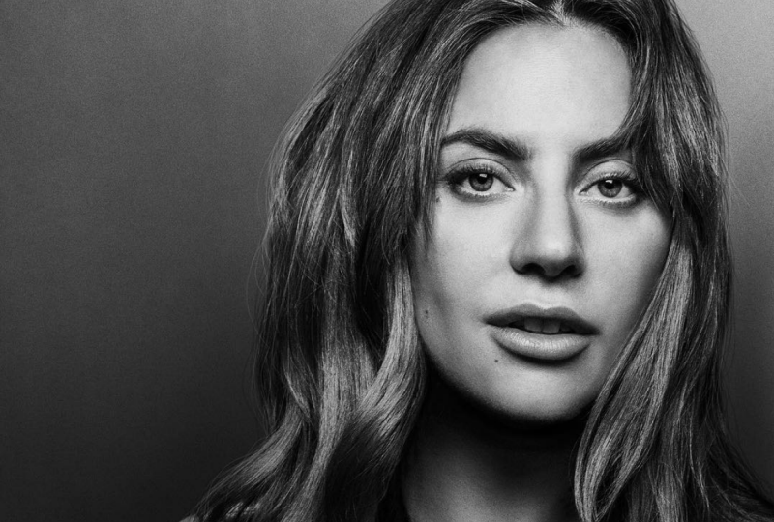
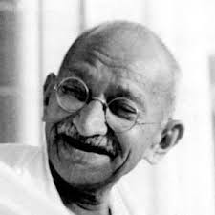
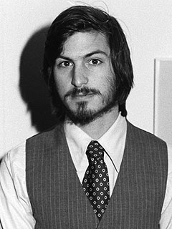
20 Questions Game
What would you ask?
Is it Lady Gaga?
Is it Mahatma Gandhi?
Is it Steven Jobs?
That takes millions of questions
But you have only 20!
Instead you try to ask halving questions...
Are they female?
Apply that solution to Locked-in Syndrome

Slide 24
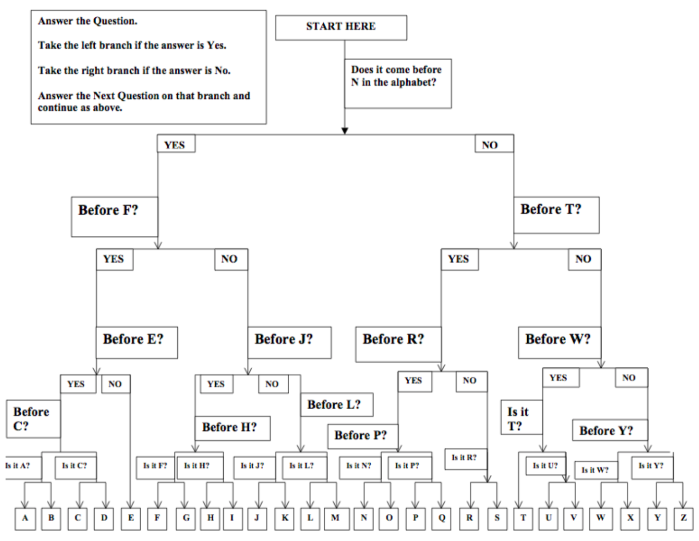

Slide 25
Search Algorithms
We have looked at two different ways of searching for information
Two different algorithms
Linear search
Binary search

Slide 26
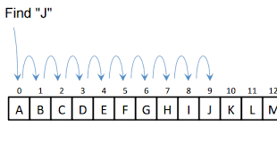
Linear Search Algorithm
Search one by one
Values can be in random order

Slide 27
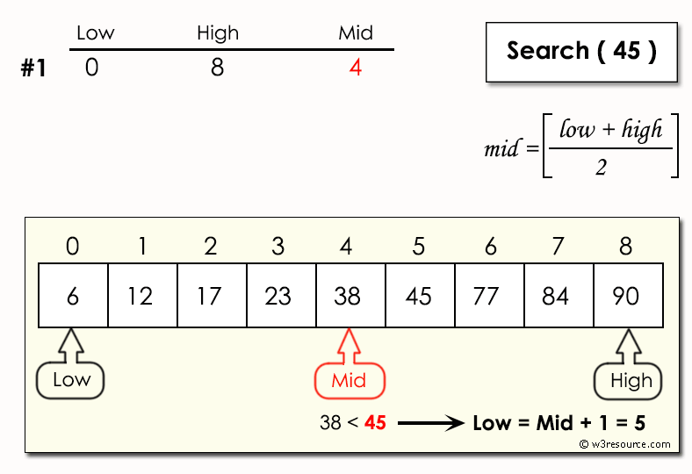
Binary Search Algorithm
Values need to be in order
Divide and conquer
Halving search

Slide 28
Did we get it right?
Did we count the right thing?
What if blinking is hard work for Mia? – We should have found out first.
Have we made her life better or worse?
Computing is about understanding people too.

Slide 29
In Summary
Practice on your logic puzzles. Revise your lectures.
They are designed to develop life-long Computational Thinking skills.
These essential life skills are not only applicable to the workplace.
All the best for your Phase Test!

